Slide 1
CZ1015 Mini Project Presentation
Kenneth Lee U1922011L
Aneez Jaheez U1922298C
Yeong Wei Xian U1921382J
You Zhi Min U1922320J

Slide 2
01
02
INTRODUCTION & VISUALIZATION
PREPARATION & CLEAN UP
03
04
PREDICTION
CONCLUSION
Wei Xian
Aneez
Kenneth
Zhi Min

Slide 3
01.
Introduction
Speaker: Wei Xian

Slide 4
Can we predict the fatality of accidents?
Problem statement

Slide 5
Introduction: Dataset
Only some columns from the aviation dataset will be used

Slide 6
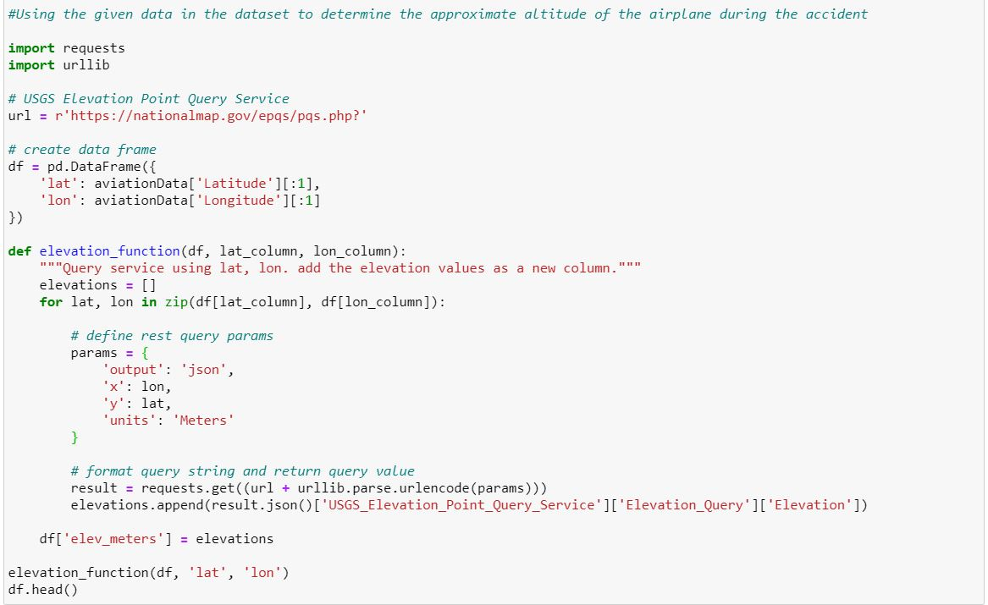
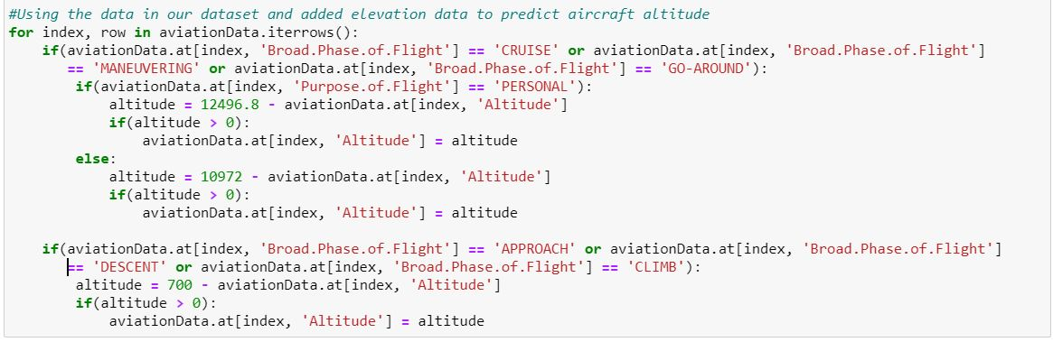
Introduction: Dataset
We used the Latitude and Longitude data to obtain the elevation of the airplane from sea level, the elevation is then used to estimate the altitude of the airplane - ‘Altitude’

Slide 7
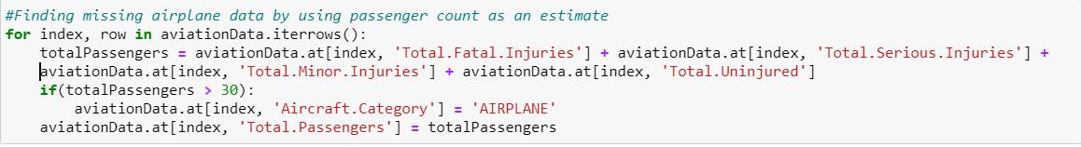
Introduction: Dataset
We used the Total.Fatal.Injuries, Total.Severe.Injuries, Total.Minor.Injuries and Total.Uninjured columns to obtain the total number of passengers in the airplane - ‘Total.Passengers’

Slide 8
Preparation & Visualization
.02
Speakers: Wei Xian & Aneez
Notes:
Aneez and Wei Xian can use the following slides for Visualisation

Slide 9
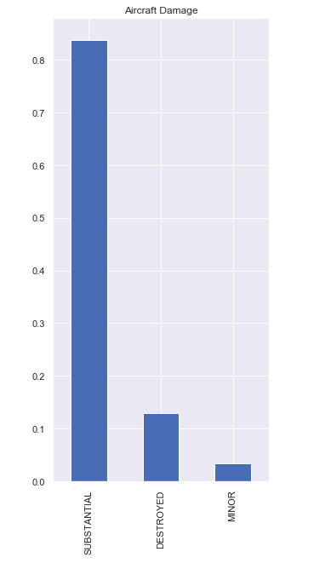
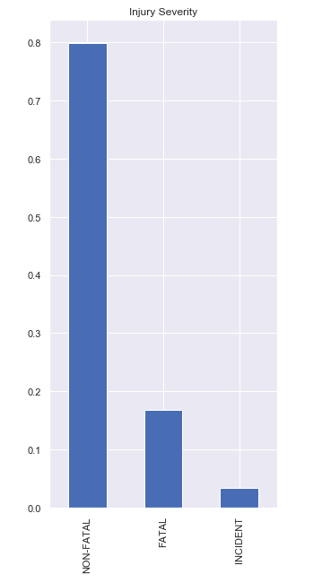
Exploration and Data Preparation
CHALLENGES FACED
Data Wrangling
How do we account for the missing data in the dataset?
How do we account for duplicate and inaccurate data in the dataset?
Data balancing:
How do we deal with categorical data that is heavily biased?

Slide 10
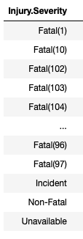
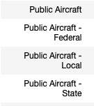
Data Cleanup: Duplicate and irrelevant data
Closely related values mapped to a single consistent value.
Professional built commercial and personal aircrafts were isolated for the prediction models.
The “Engine type”, “Purpose of Flight”, “Number of Engines” and “FAR.Description” were used to accurately isolate commercial aircrafts.

Slide 11
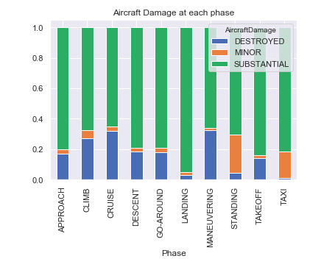
Data Cleanup: Missing Values
Aircrafts with more than 30 passengers were assumed to be airplanes.
Important Fields with missing data:
Latitude
Longitude
Passenger and injury counts
Aircraft Damage level
Weather condition
Other fields with missing data:
Purpose of Flight
Engine type and count

Slide 12
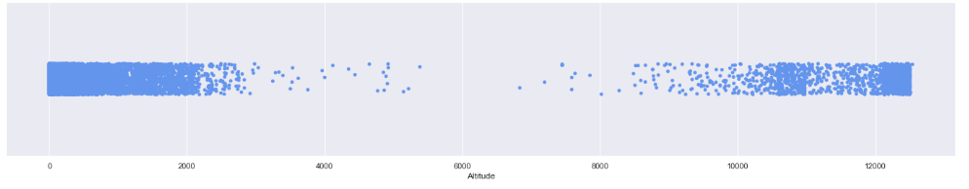
Data Cleanup: Missing Values
Missing latitude and longitude values were replaced by the mean of their respective columns.
Using the latitude and longitude, the elevation of land at that point on earth was retrieved.
The elevation, Purpose of Flight and Phase of flight were then used to determine the altitude of the airplane.

Slide 13
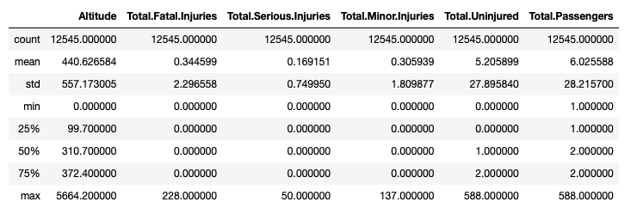
Data Cleanup: Incorrect Data
Corrections made by accounting for mismatches in values across different fields of each record.
Since the Phase of Flight is a crucial attribute in altitude estimation, records with “Unknown” or missing values in this field were discarded.
The remaining null records were dropped, resulting in a complete dataset with 12,545 records.

Slide 14
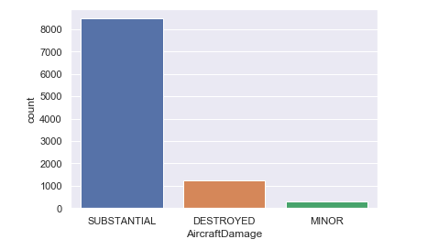
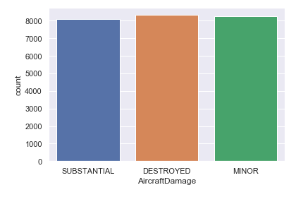
Data Cleanup: Data Balancing
Imbalanced data presents a lot of bias in the case of classification models.
Data balancing carried out using the “SMOTE Tomek” class in the “imblearn” library.
Upsampling of the minority class by introducing synthetic records that mimic the minority class.
Downsampling was not considered due to the lack of records in the minority class.
Before upsampling
After upsampling

Slide 15
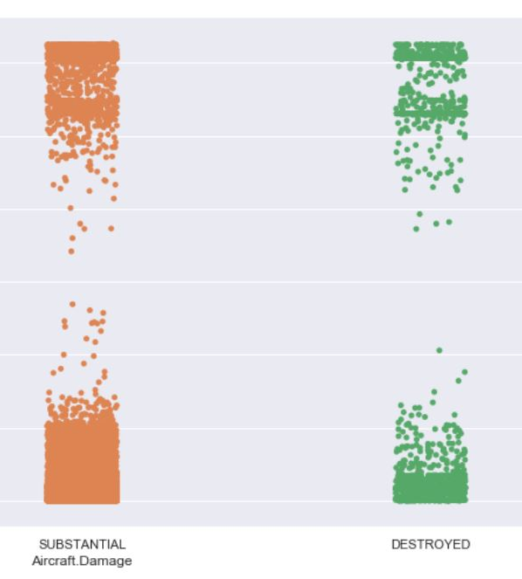
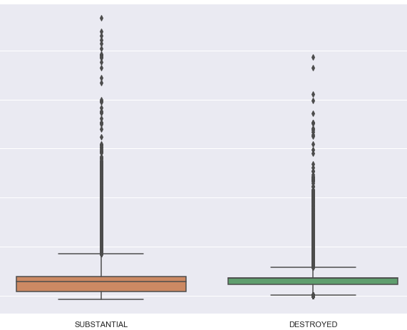
Visualization
Due to the large number of outliers we used stripplot instead of boxplot in all of our data representation

Slide 16
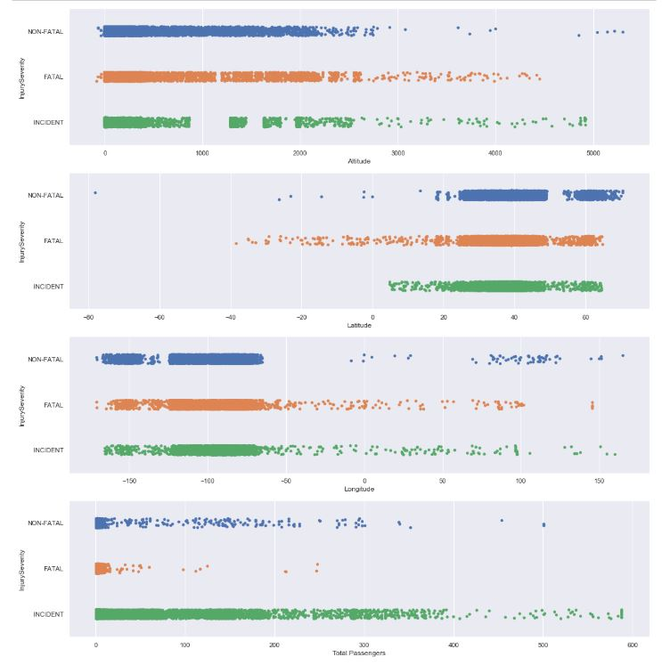
Visualization
Relationship between several numeric columns and Injury.Severity

Slide 17
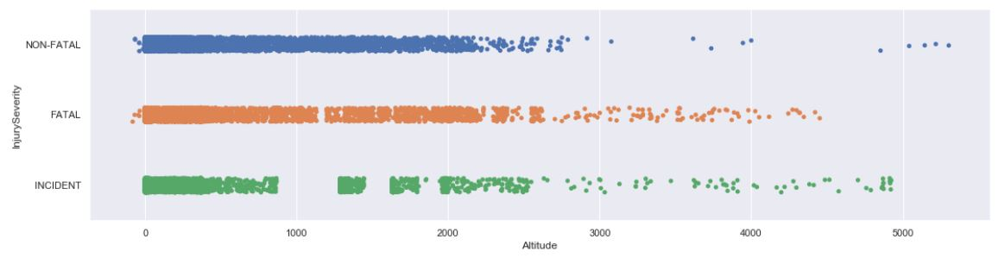
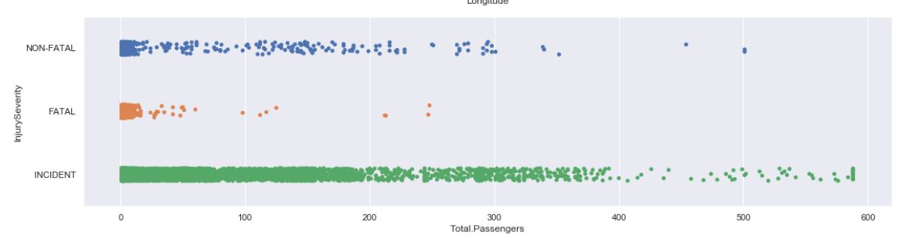
Visualization
Relationship between several numeric columns and Injury.Severity

Slide 18
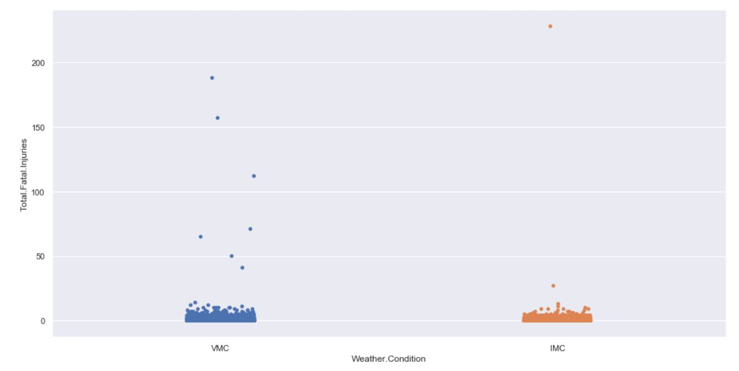
Visualization
Relationship between Weather.Condition and Total.Fatal.Injuries

Slide 19
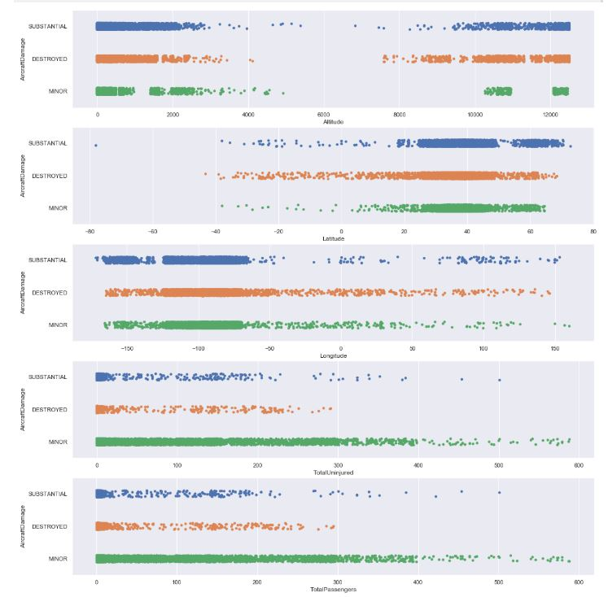
Visualization
Relationship between several numeric columns and Aircraft.Damage

Slide 20
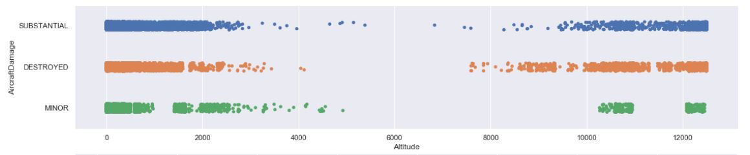
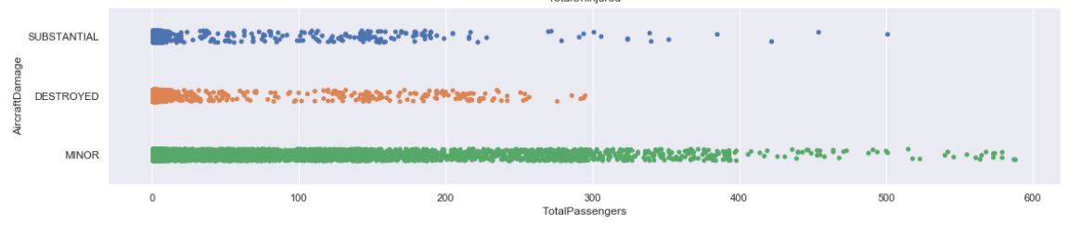
Visualization
Relationship between several numeric columns and Aircraft.Damage

Slide 21
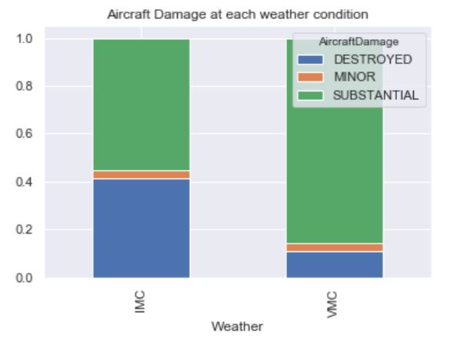
Visualization
Relationship between Weather.Condition and Aircraft.Damage

Slide 22
03.
Prediction
Speaker: Kenneth

Slide 23
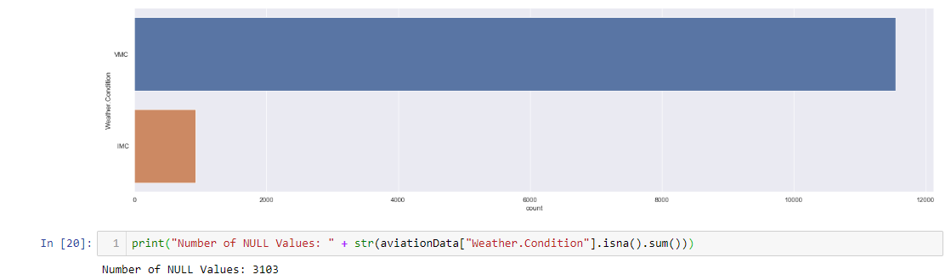
Predicting Weather Using Decision Tree

Slide 24
Boosting our base tree using Adaboost
Base tree
Train Dataset
Test Dataset (Adaboosted)
Goodness of Fit of Model Train Dataset
Classification Accuracy : 73.09526079908458%
Goodness of Fit of Model Train Dataset
Classification Accuracy : 81.19047619047619 %

Slide 25
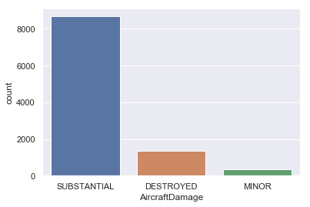
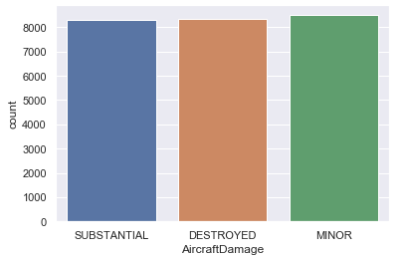
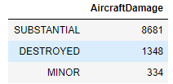
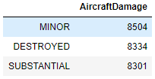
Predicting Aircraft Damage Using Decision Tree
Predictors: Altitude, Latitude, Longitude, Total.Uninjured, Total.Passengers

Slide 26
Boosting our base tree using Adaboost
Base tree
Train Dataset
Test Dataset
Goodness of Fit of Model Train Dataset
Classification Accuracy : 71.47637638435185 %
Goodness of Fit of Model Test Dataset
Classification Accuracy : 52.25781551524508 %
Adaboost
Train Dataset
Test Dataset
Goodness of Fit of Model Train Dataset
Classification Accuracy : 76.63931160863676 %
Goodness of Fit of Model Train Dataset
Classification Accuracy : 72.94480895407179 %
~+5%
~+20%

Slide 27
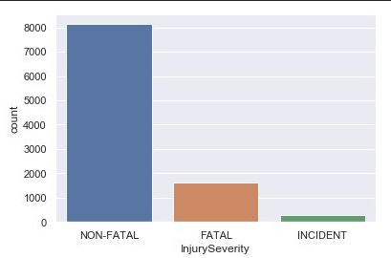
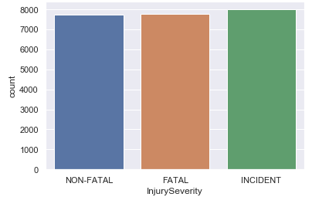
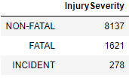
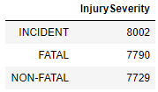
Predicting Injury Severity Using Decision Tree
Predictors: Altitude, Latitude, Longitude, Weather.Condition, Total.Passengers

Slide 28
Boosting our base tree using Adaboost
Base tree
Train Dataset
Test Dataset
Goodness of Fit of Model Train Dataset
Classification Accuracy : 55.58437141278006%
Goodness of Fit of Model Test Dataset
Classification Accuracy : 69.46990833001195%
Adaboost
Train Dataset
Test Dataset
Goodness of Fit of Model Train Dataset
Classification Accuracy : 63.21159814633731 %
Goodness of Fit of Model Train Dataset
Classification Accuracy : 70.10761259465923 %
~+8%
~+1%

Slide 29
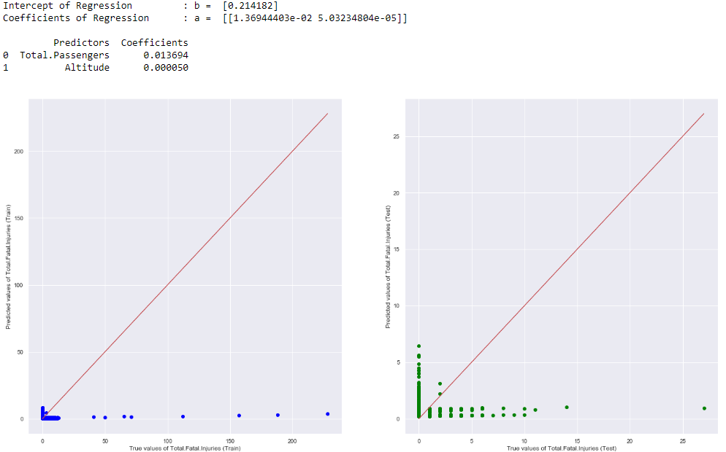
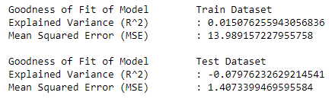
Predicting number of Fatal.Injuries using Linear Regression

Slide 30
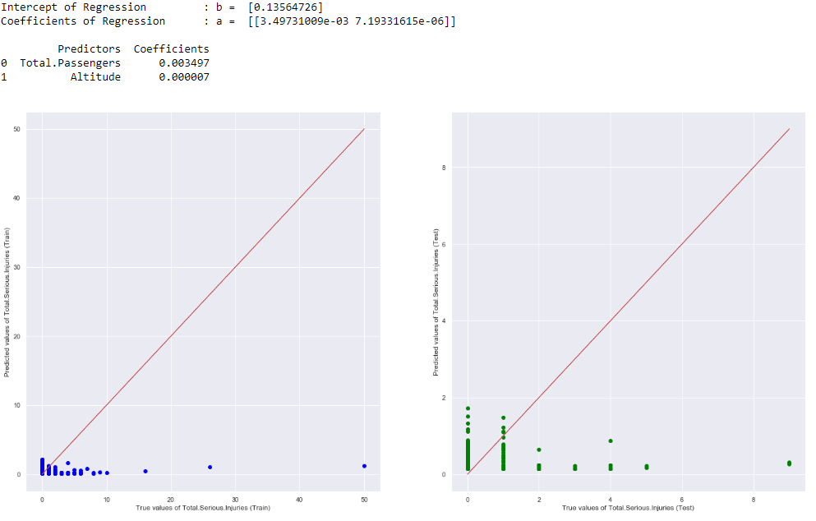
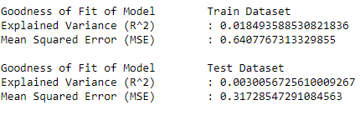
Predicting number of Serious.Injuries using Linear Regression

Slide 31
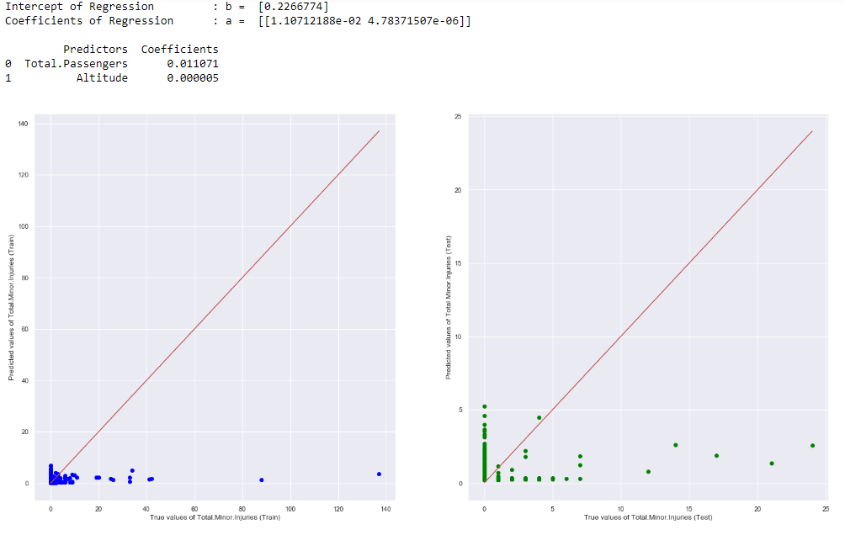
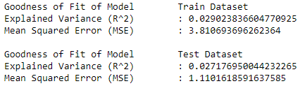
Predicting number of Minor.Injuries using Linear Regression

Slide 32
Conclusion
.04
Speaker: Zhi Min

Slide 33
Can we predict the fatality of accidents?
Problem statement

Slide 34
Outcome of Project
From our problem statement, we successfully predicted the fatality of accidents with 70% accuracy.

Slide 35
Linear Regression VS Decision tree
Goodness of Fit of Model Train Dataset
Classification Accuracy : 70.10761259465923 %
From trying both linear regression and decision tree, we can see that decision tree with AdaBoost was able to better predict the injury severity
We were able to predict the injury severity and aircraft damage with about 70% accuracy.

Slide 36
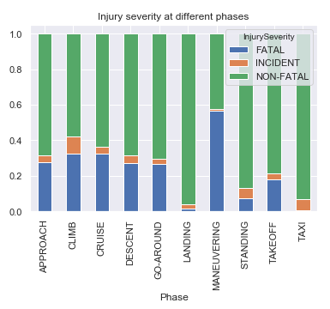
Interesting facts
we notice that the majority of destroyed aircraft and fatal accidents happened when the plane was in the maneuvering phase

Slide 37


Interesting facts
We also noticed that for airplanes with more passengers are generally safer from the accident percentages
*FATAL: Accidents with fatality
*NON-FATAL: Accidents with Minor/Severe injury
*INCIDENT: Not an accident, Minor incidents on the plane that is reported for safety reasons

Slide 38
Contributions
Kenneth
Aneez
Wei Xian
Zhimin
Prediction of Injury Severity & Linear Regression :)
Data cleanup, balancing, and exploratory analysis
Prediction of Aircraft Damage & Decision Tree
Prediction of weather condition
AdaBoost models

Slide 39
Thank you!
Q & A

